Slide 1
Zoom Guidelines
Assume good faith from your colleagues. We are all here to learn together.
Recognize and respect others' feelings, background, and cultural differences.
Please use the “chat” or “raise hand” function if you wish to share verbally.
If you are speaking, please speak slowly for our ASL and closed captioners.
Try to limit yourself to 30 seconds or less. It can be just as courageous to listen as it is to share.

Slide 2
CTE 101 Career & Technical Education
Amanda Nolasco, School Counselor Specialist, Arizona Department of Education (ADE)
Sam Klein, Lead Special Projects Specialist, Arizona Department of Education (ADE) July 7, 2022
Notes:
Font: Proxima Nova Font Colors & Fill Colors: RGB 12, 35, 75 (Arizona Blue) RGB 171, 5, 32 (Arizona Red)
AUCD Standards for PowerPoint Presentations:
Text content
Title fonts should be 44 pt. or greater. Text fonts should be 36 pt. or greater
Don't try to cram too many slides into your presentation. Allow your audience time to read slides.
Place no more than 6 lines of text on a slide (excluding columns).
Many people with disabilities use text-based screen reading software and computer devices.
Note that graphics often cannot be read with screen readers and other text-based devices.
Graphic content
Replace graphics with text whenever possible.
If graphics are used, include a detailed explanation of the meaning of that charts or graphic in a descriptive text-only slide included immediately after the graphic slide. Note that the meaning of the graphic is needed, not a description. For example:
No: "Chart with blue and red bars."
Yes: "Data from this chart illustrates that people with disabilities report spending more time in the emergency room than people without disabilities."
Avoid:
Slide transitions
Busy slide backgrounds
Chart filler patterns
Over-crowding text
Color schemes providing low contrast
Charts without text descriptions

Slide 3
Career & Technical Education (CTE)
Career Technical Education is an educational option that provides learners with the knowledge, experiences and skills they need to be prepared for college and careers.
CTE gives purpose to learning by emphasizing real-world skills and practical knowledge within a selected career focus. Students in CTE pathways take specialized courses, in addition to required core courses, at the secondary and postsecondary/adult levels.

Slide 4
ADE Vision and Mission for CTE
Vision
Develop Arizona’s competitive workforce through the power of Career and Technical Education
Mission
Career and Technical Education will engage Arizona Learners in relevant experiences leading to purposeful and economically viable careers

Slide 5
CTE: From Past to Present
Vocational Education (The Past) | Career & Technical Education
High School Focused | Links Secondary, Postsecondary and Workforce
6 to 7 Program Areas | 16 Career Clusters with 79 Career Pathways
In Lieu of Academics | Supports and Reinforces Academic Learning
Tracked | Fully Integrated
Terminal | Continuous, Lifelong Learning

Slide 6
What is CTE?
Career Technical Education is
Classroom
Instruction
Hands-On
Instruction
Work Based
Learning
Leadership
Development

Slide 7
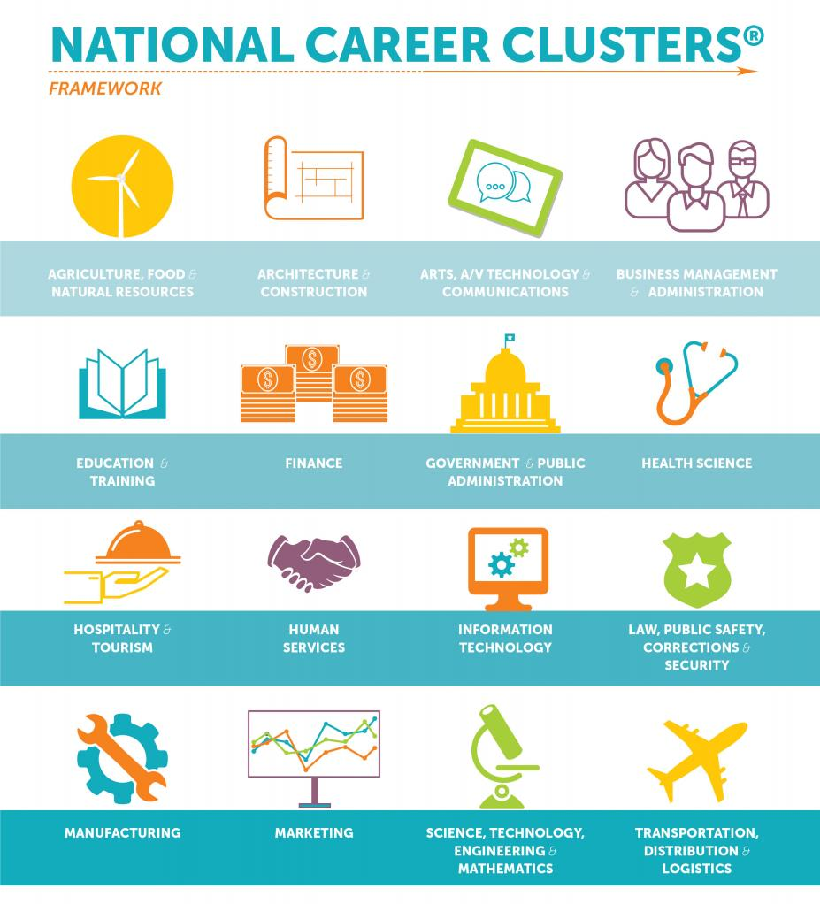
CTE Career Clusters
16 Career Clusters (groups of careers that share common features)
The Career Clusters are in the process of being revised and should be released late 2022 or early 2023.

Slide 8
CTE Programs and Standards
Approved CTE programs are determined by Labor Market Information
Approved CTE Program list is developed on a biannual basis
Based on local needs, the LEA may choose to open or sunset existing programs
Technical Skill Standards are developed for each program by a committee of related industry members to align standards with recognized industry certifications, credentials, or licenses
From those standards ADE/CTE collaborates with the Arizona Curriculum Consortium to develop a scope and sequence, framework, blueprint, and lessons
The Technical Skills Assessments (TSA) are end of program assessments
Students concentrating in a program will take the TSA at the end of the program
https://www.azed.gov/cte/programs

Slide 9
CTE Program Sequence
CTE Content Specific Area of Interest
Introductory Course
Concentrator Course
Some programs have a 3rd Carnegie unit
Pass the TSA and obtain industry credential
Pass the TSA and obtain industry credential

Slide 10
CTE Credentials
Industry recognized credentials are an important part of CTE.
Required performance measure for Perkins V
CTE program must lead to certification for CTED funding – per legislature
Generates points on CCR for school letter grade
Arizona Industry Incentive Fund
Class of 2020
4,459 students obtained a credential
$1000 goes back to student’s district CTE department
About $4.4 million
https://www.azed.gov/cte/cte-industry-credentials

Slide 11
Technical Skills Assessment (TSA)
Secure, reliable, online test application owned by the State of Arizona and housed in the Department of Education
Designed to certify and document student attainment of industry-validated knowledge and skills
Assessments designed for students in their final Carnegie Unit of state-identified CTE program
Schools register students, conduct assessments, and access summary reports on the ADE website
Students who pass the assessment receive a certificate endorsed by Arizona’s business leaders
https://www.azed.gov/cte/assessments

Slide 12
Technical Skills Assessment (TSA) Matters
Schools earn A-F points for students who complete a CTE program and pass the TSA
The State Legislature looks at TSA scores to determine funding for CTE programs
TSA data is a component of the performance measures for the federal Perkins grant
Successfully passing the TSA builds students' confidence to enter their chosen professions
https://www.azed.gov/cte/assessments

Slide 13
Career Technical Student Organizations (CTSO)
Develop academic success
Career development
Professional skill development
Competitions – regional, state, and national
https://www.azed.gov/cte/programs

Slide 14
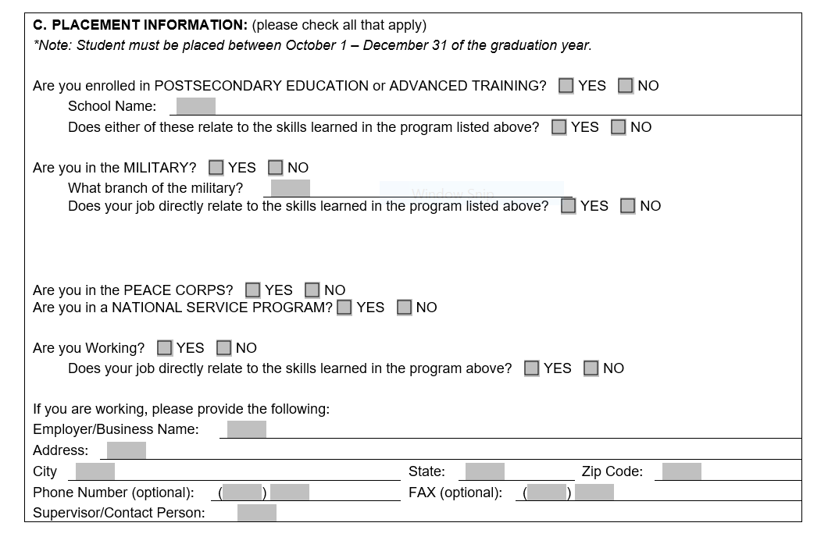
CTE Placement Survey
Captures the post high school activities of CTE concentrator
6 months after graduation
Required for all active programs
Impacts state funding—not federal
https://www.azed.gov/cte/cte-placement
Notes:
Mention alignment with Indicator 14/PSO Survey 1-year after exit for students with IEPs

Slide 15
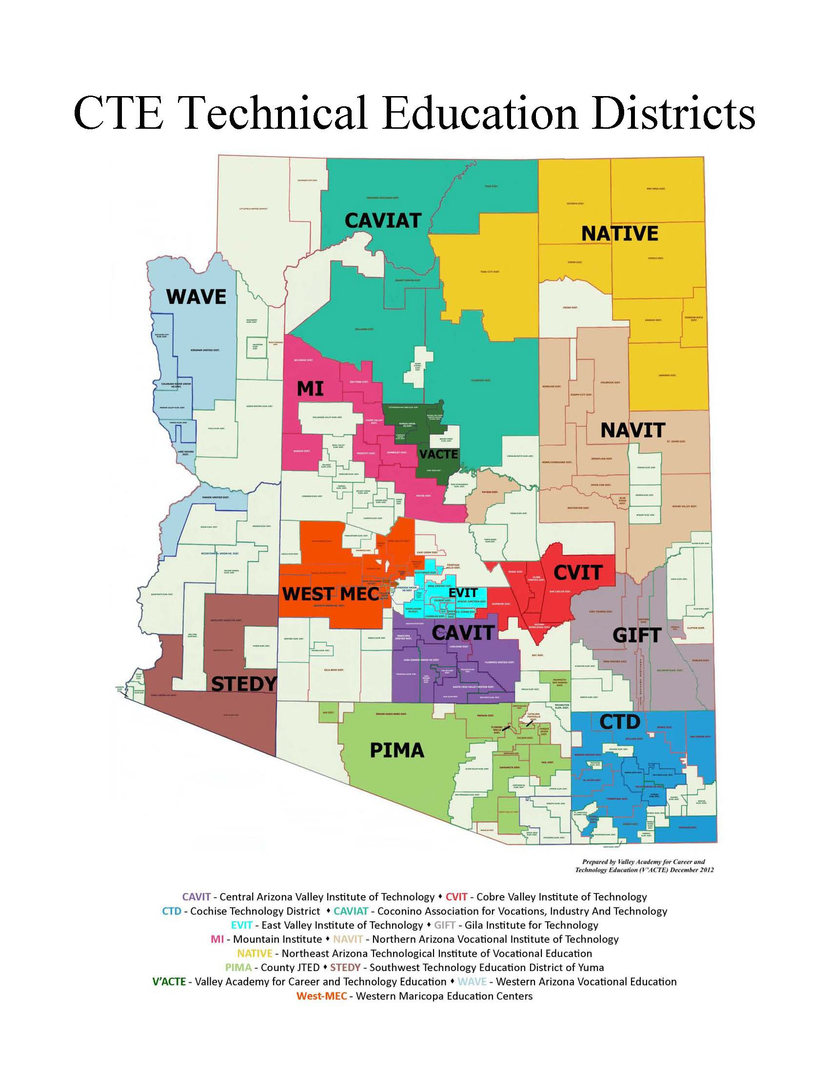
CTE Technical Education Districts (CTEDs)
CTE Technical Education District List and Map (pictured)
https://www.azed.gov/cte/cted
Notes:
CAVIT - Central Arizona Valley Institute of Technology
CVIT - Cobre Valley Institute of Technology
CTD - Cochise Technology District
CAVIAT - Coconino Association for Vocations, Industry And Technology
EVIT - East Valley Institute of Technology
GIFT - Gila Institute For Technology
MICTED - Mountain Institute CTED
NAVIT - Northern Arizona Vocational Institute of Technology
NATIVE - Northeast Arizona Technological Institute of Vocational Education
Pima County JTED
STEDY - Southwest Technology Education District of Yuma
V'ACTE - Valley Academy for Career and Technology Education
WAVE - Western Arizona Vocational Education
West-MEC - Western Maricopa Education Centers

Slide 16
Myth vs. Fact
Myth
Only non-college bound students take CTE classes
Fact
CTE Provides a seamless pathway to postsecondary education
78% of CTE concentrators enroll in postsecondary education full-time immediately after graduating
CTE students have many opportunities to earn college credit in high school through dual and concurrent enrollment
http://s3.amazonaws.com/PCRN/docs/NACTE_FinalReport2014.pdf
Slide credit to AdvanceCTE

Slide 17
Myth vs. Fact 2
Myth
CTE doesn’t build academic skills
Fact
CTE blends academic and technical skills to enhance the learning experience
CTE programs, technical coursework reinforce core academics, enabling learners to strengthen their academic studies with real-world learning
Perkins has three performance measures for CTE students in ELA, Math, and Science
Districts must meet 90% of the State Determined Level of performance to be compliant
Slide credit to AdvanceCTE

Slide 18
Myth vs. Fact 3
Myth
CTE serves only “disadvantaged” students
Fact
CTE is for all learners
92% of high school students take some form of CTE
33% of students in the highest socio-economic status quartile took three or more CTE credits
91% of parents of CTE students were satisfied with the way CTE helps their children get a leg up on future careers
http://www.nrccte.org/sites/default/files/publication-files/nrccte_cte_typology.pdf
https://cte.careertech.org/sites/default/files/CTE_Myths_and_Facts_2017.pdf
Slide credit to AdvanceCTE

Slide 19
Myth vs. Fact 4
Myth
CTE is jobs training
Fact
CTE empowers learners to explore multiple career options
CTE programs provide career specific technical skills and knowledge
CTE provides hands-on training mentoring and internships to expand professional networks
Students understand real-world value CTE provides
Slide credit to AdvanceCTE

Slide 20
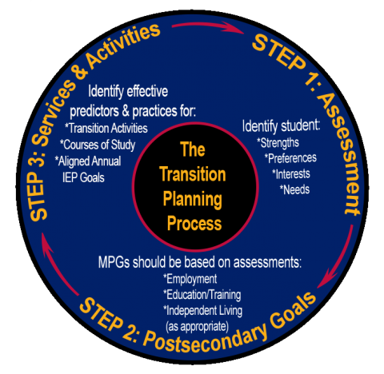
Connection to the IEP Transition Plan
Teacher reports, grades, and student interview information about CTE participation can provide Age-Appropriate Transition Assessment data
CTE courses may align with a student’s Measurable Postsecondary Goals (MPGs)
An assignment, task, or project from CTE courses may be considered a Transition Activity
CTE courses are identified within the Courses of Study section
Students may work toward Aligned Annual IEP Goal(s) in a CTE course

Slide 21
CTE Recruitment and Retention of Students with Disabilities in Arizona
Interagency Goal: Aligning and developing training and resources to assist LEAs, VR staff, and CTE staff in the recruitment and retention of students with disabilities accessing and participating in CTE programs.
Recorded Webinars:
CTE Recruitment for Inclusion of Students with Disabilities: Innovative Strategies from a Panel of Your Peers – September 2021
CTE Recruitment and Retention for the Inclusion of Students with Disabilities: Innovative Strategies from a Panel of Your Peers – March 2022

Slide 22
Resources
ADE CTE www.azed.gov/cte
ADE Exceptional Student Services/Secondary Transition http://bit.ly/AZsecondarytransition1
ACTE (Association for Career & Technical Education) www.acteonline.org
ACTEAZ (Association for Career & Technical Education Arizona) www.acteaz.org
Advance CTE www.careertech.org

Slide 23
Contact Information
ADE/ESS Secondary Transition Team
ESSTransition@azed.gov
Secondary Transition website: http://bit.ly/AZsecondarytransition1
School Counselors website: www.azed.gov/cte/counselors

Slide 24
QUESTIONS & DISCUSSION
Notes:
17

Slide 25
Registered Apprenticeship Program
Department of Economic Security July 7, 2022

Slide 26
Earn while you Learn
Industry Driven

Slide 27
Five core components of registered apprenticeship

Slide 28
Program For Everyone
4,502 registered apprentices
115 different occupations
6.7% Veterans
10.2% Females
2.2% PWDs

Slide 29
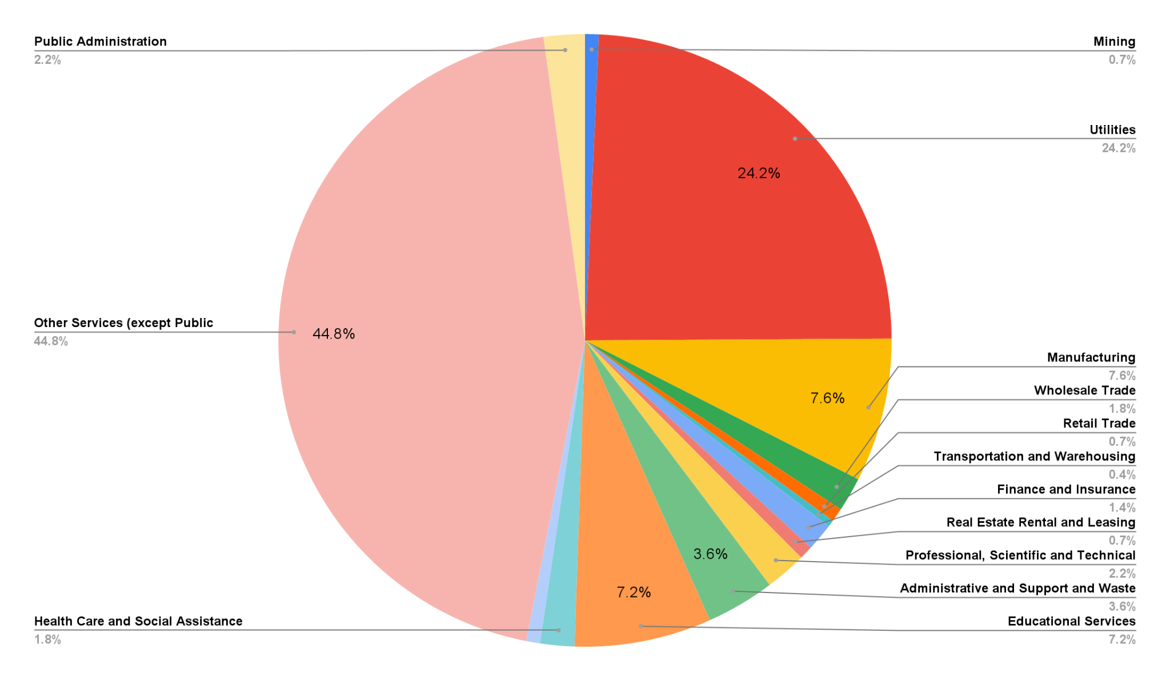
Arizona Apprenticeship Industries

Slide 30
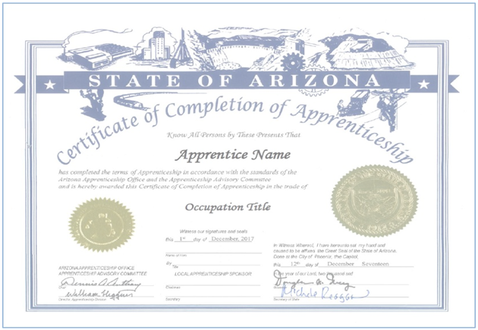
Registered Apprenticeship Benefits
Increased skills
Higher wages
National credential
Career advancement
Often receive college credits that can apply toward an associate or bachelor’s degree
529 Plans, GI Bill, etc.

Slide 31
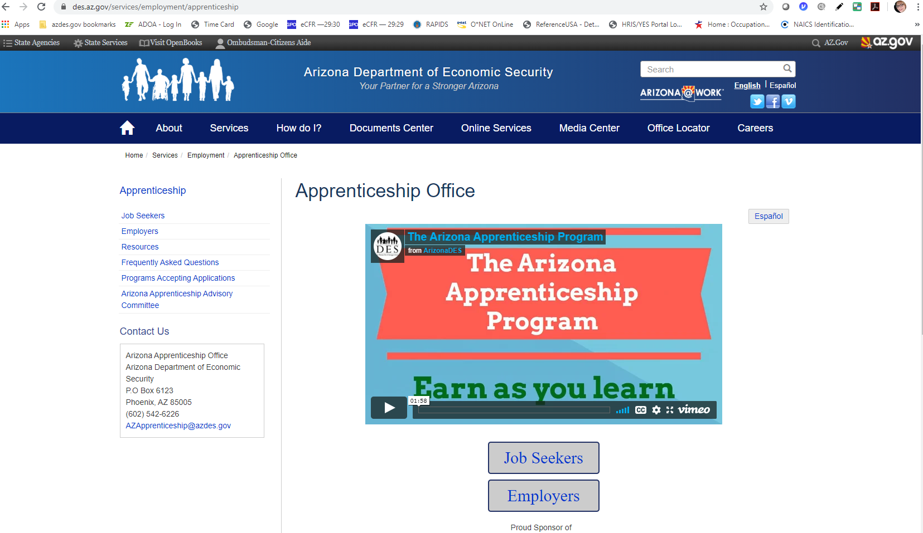
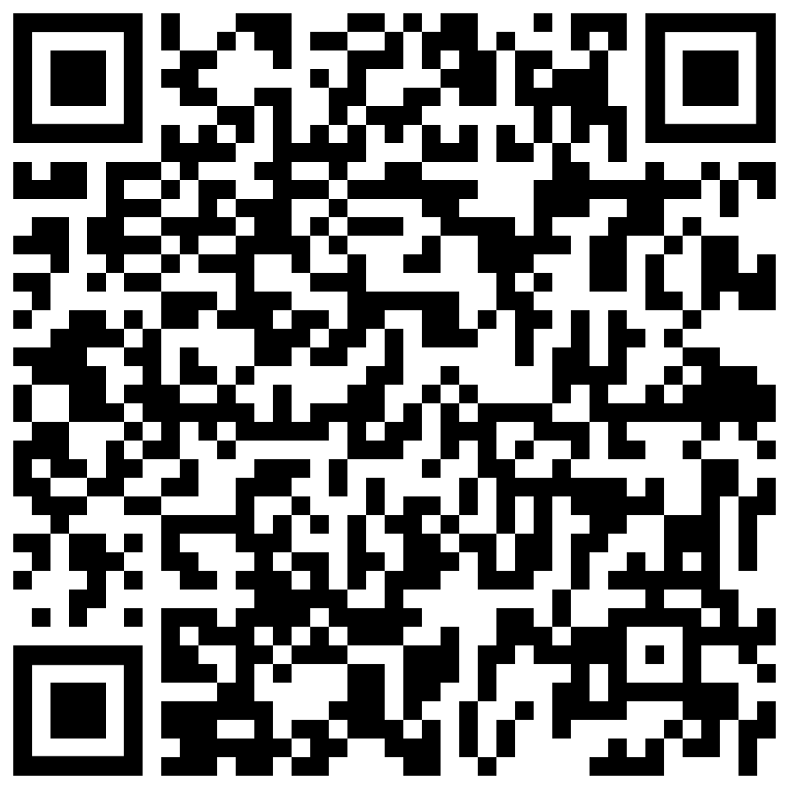
Visit our website
Visit our website at AZApprenticeship.com
Click on
“Programs Accepting Applications”

Slide 32
video
https://www.apprenticeship.gov/become-apprentice

Slide 33
Visit us at www.AZApprenticeship.com - or - Email us at AZApprenticeship@azdes.gov

Slide 34
QUESTIONS & DISCUSSIONs
QUESTIONS & DISCUSSION
Notes:
17

Slide 35
Thank you for joining us!
Please remember to take our survey
We have two upcoming webinars
August 11 - An Unexpected Journey: My Story Through a Person-Centered Planning Lens
September 8 - Why Employment First Must Be a Priority in Arizona

